Slide 1

AI Summer Camp

Slide 2
What will we talk about today
What are Tensor and TensorFlow?
TensorFlow Basics
What is Keras?
Sequential and Functional Models
Building and Training the First Model
Transfer Learning with TensorFlow

Slide 3
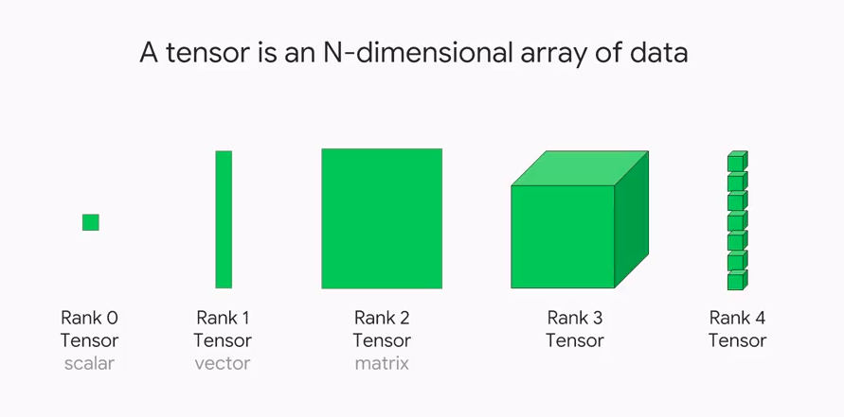
Tensor

Slide 4
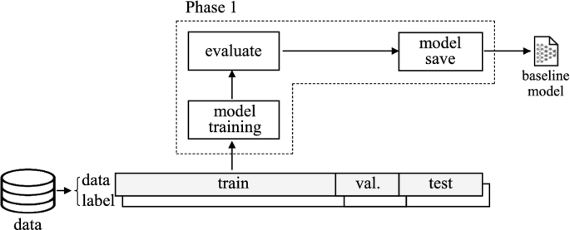
General Deep Learning Workflow
You will follow the general deep learning workflow.
Examine and understand the data
Build an input pipeline, in this case using Keras ImageDataGenerator
Compose the model
Load in the pretrained base model (and pretrained weights)
Stack the classification layers on top
Train the model
Evaluate model

Slide 5
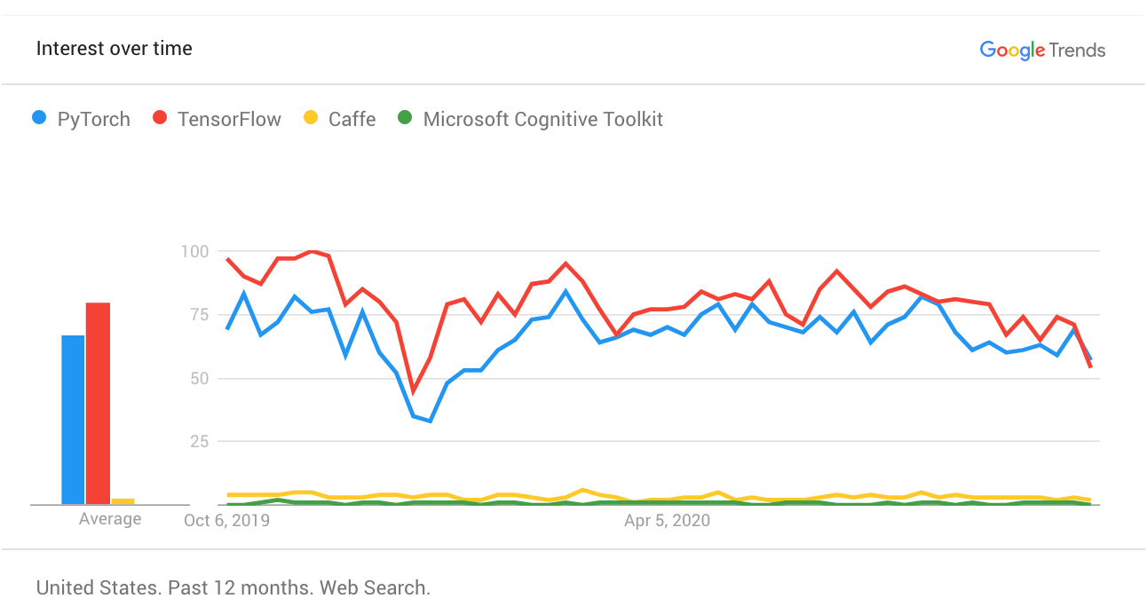
Deep Learning Framework
TensorFlow
Keras
PyTorch
Gluon
Microsoft CNTK
Chainer
DL4J

Slide 6

Let’s Meet TensorFlow
Created by Google Brain Team
Open Source
Comprehensive, flexible ecosystem of tools, libraries
Community Resources
Easy model building
Supporting multi language
Supported on Google Platforms like Google Cloud Platform, Google Cloud Speech etc

Slide 7
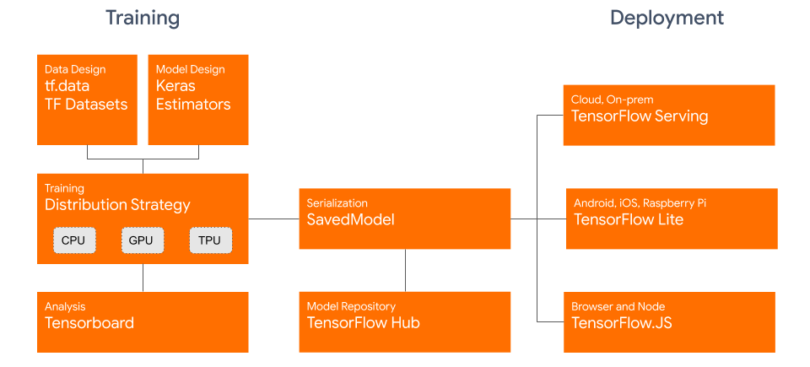
TensorFlow General Schema
TensorFlow represent more feature for us

Slide 8
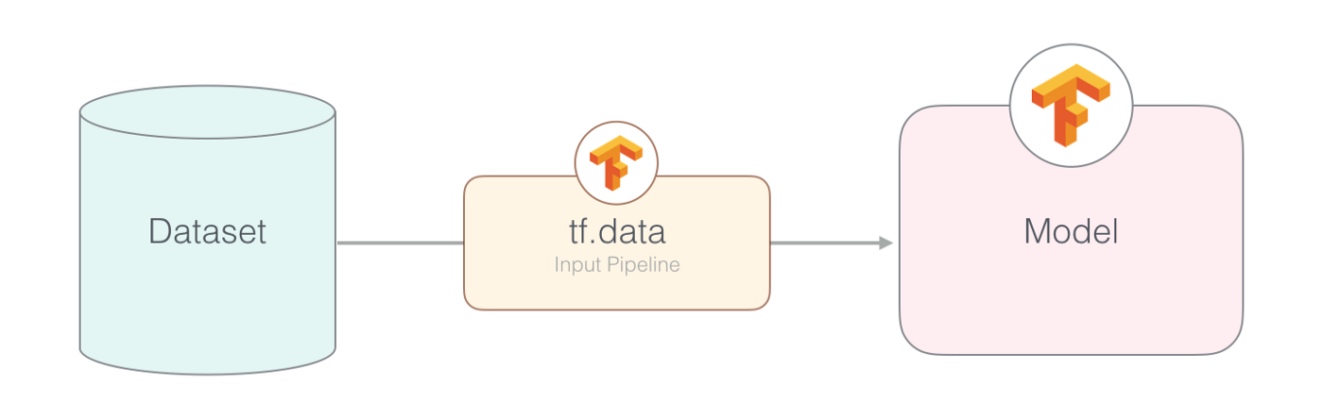
Pipeline
The pipeline for an image model might aggregate data from files in a distributed file system, apply random perturbations to each image, and merge randomly selected images into a batch for training.

Slide 9


Big Release: TensorFlow 2.x
Tensorflow 1.x
Tensorflow 2.x
Migration to TensorFlow 2x includes major changes

Slide 10
TensorFlow Ecosystem is committed to 2.x
TF 2.0
TF 2.1
TF 2.2
TF 2.3
Eager execution by default
Tight integration with Keras
Performance improvements across both graph (tf.function) and eager execution
New TF Profiler for CPU/GPU/TPU
TPU training support
Experimental tf.data as a service
Experimental Keras Preprocessing for data preprocessing
Improved TF Profiler, stable TPUStrategy
* https://github.com/tensorflow/tensorflow/releases

Slide 11
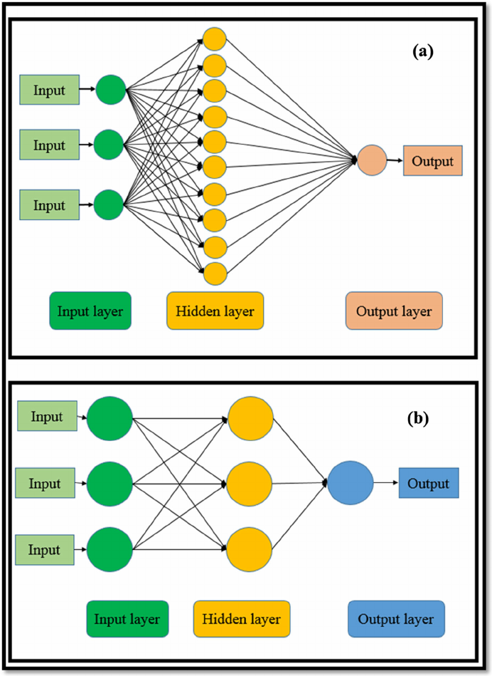
Model Design

Slide 12
Sequential and Functional Model
INPUT
LAYER
OUTPUT
LAYER
INPUT
OUTPUT
LAYER

Slide 13
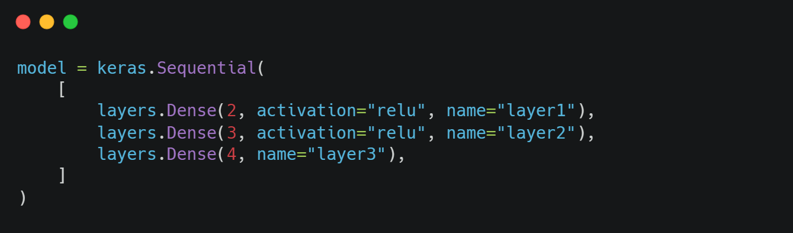
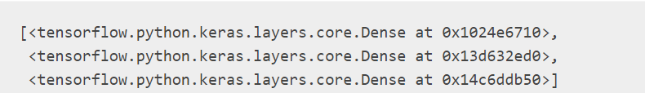
Sequential Model
A Sequential model is appropriate for a plain stack of layers where each layer has exactly one input tensor and one output tensor.

Slide 14
Sequential Model
A Sequential model is not appropriate when:
Your model has multiple inputs or multiple outputs
Any of your layers has multiple inputs or multiple outputs
You need to do layer sharing
You want non-linear topology (e.g. a residual connection, a multi-branch model)
INPUT
LAYER
OUTPUT

Slide 15
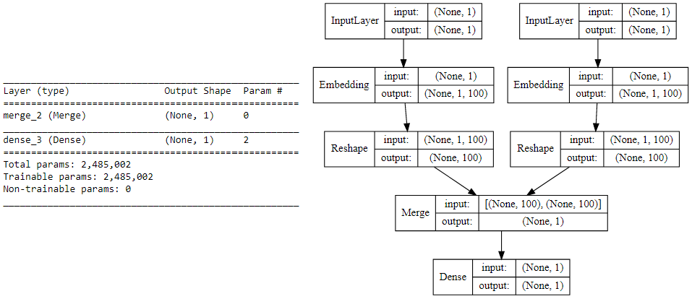
Functional Model
The functional API can handle models with non-linear topology, shared layers, and even multiple inputs or outputs.

Slide 16
Functional Layer
The functional API is a way to create models that are more flexible than the
Sequential Model API
LAYER
INPUT
OUTPUT
LAYER

Slide 17
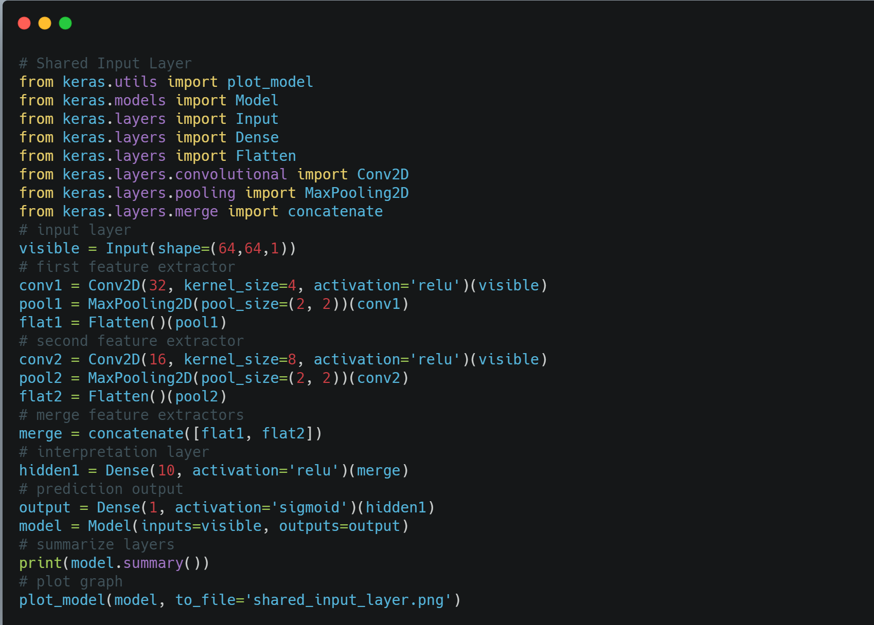
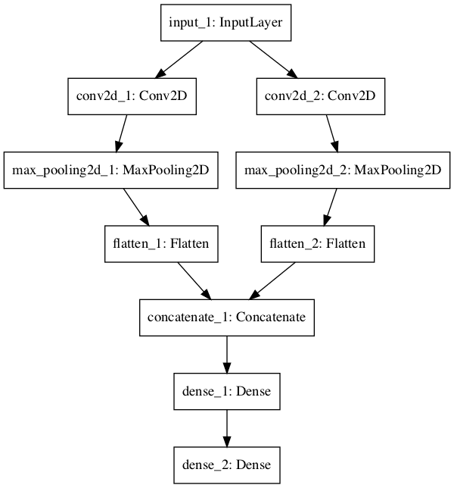
Functional Model and Share Input Layer

Slide 18
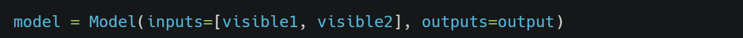
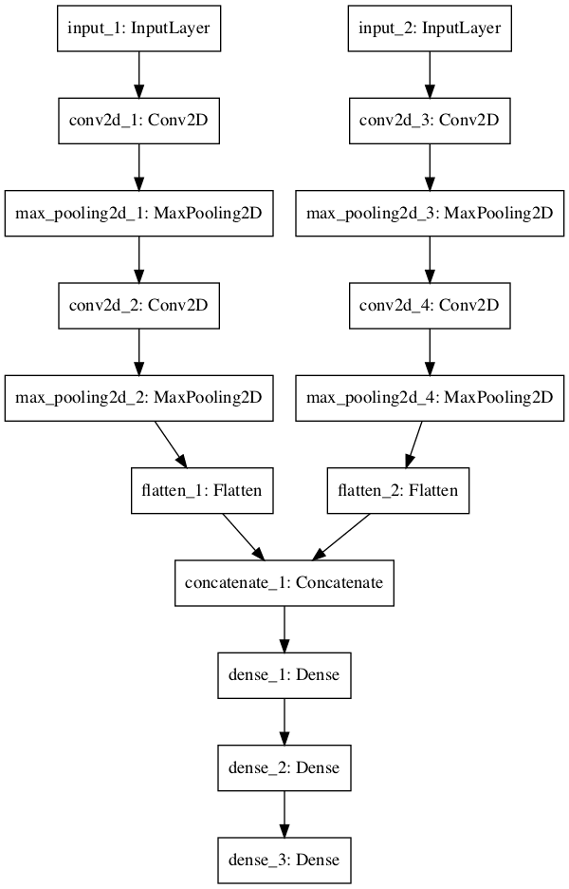
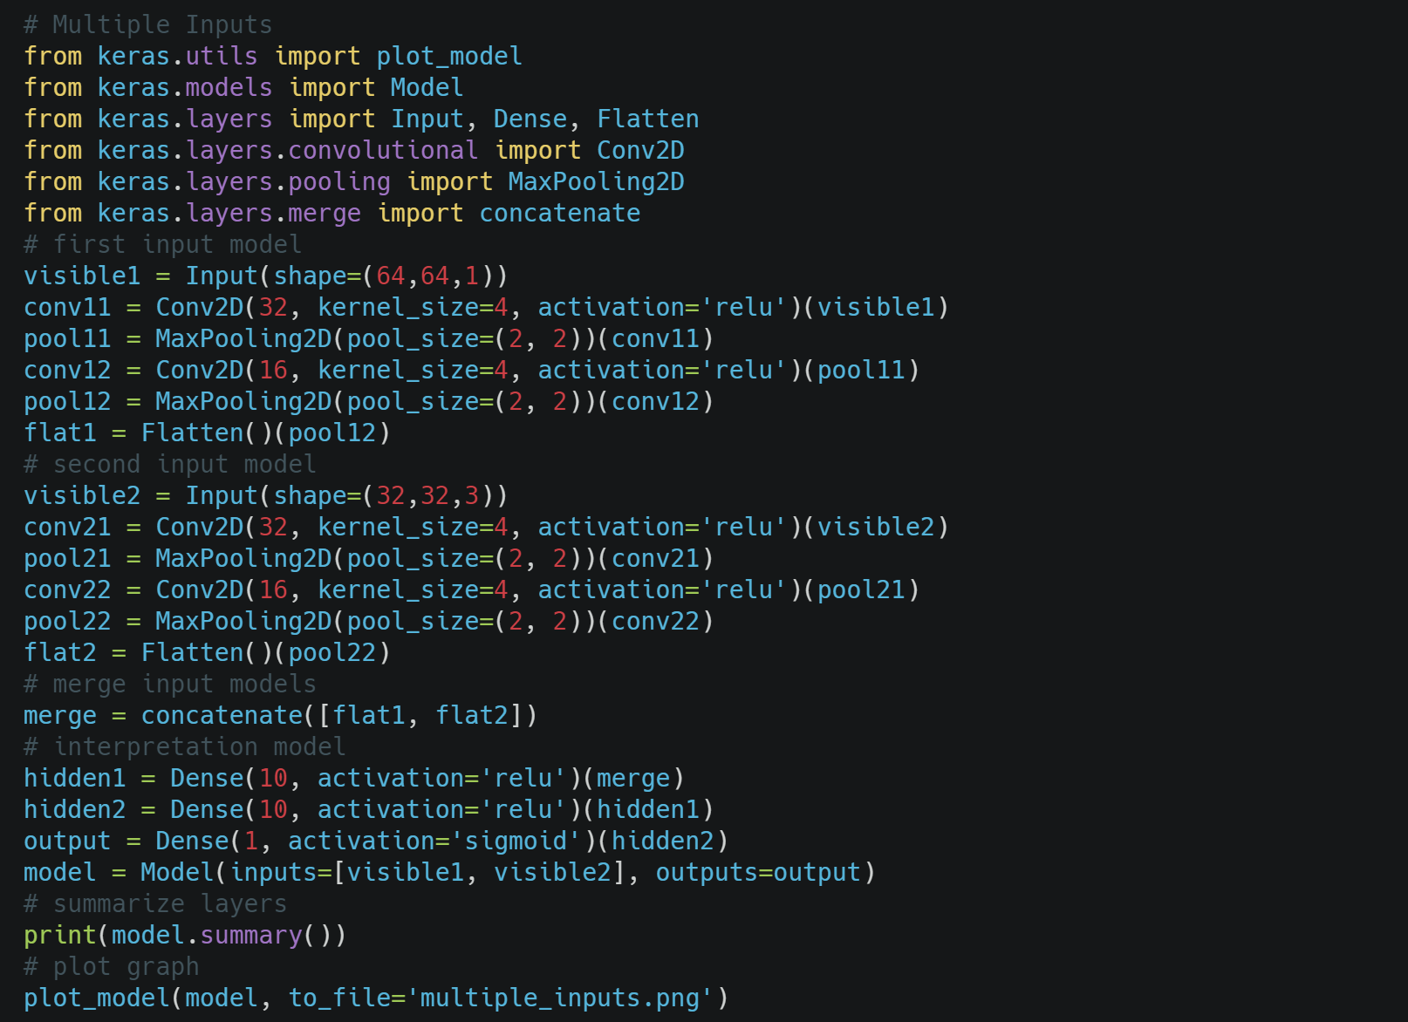
Functional Model and Multiple Input Model
Note that in the creation of the Model() instance,
that we define the two input layers as an array

Slide 19
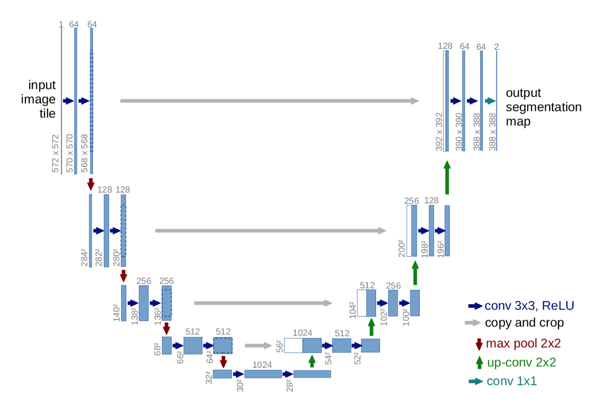
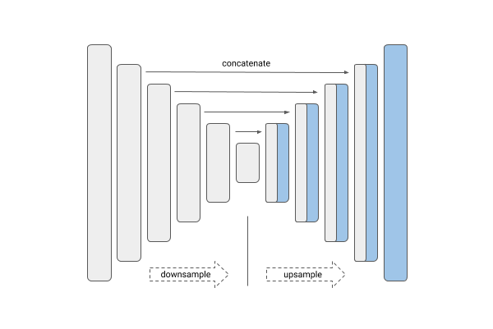
UNet and Functional API
This deep neural network is implemented with Keras functional API, which makes it extremely easy to experiment with different interesting architectures.

Slide 20

Tensorflow & Keras
TensorFlow and Keras includes;
Data preprocessing
Models API
Applications
Layer
Optimizer
Activation
Loss Function
Callbacks
Metrics

Slide 21

Let’s Meet Keras
Keras is an API designed for human beings, not machines. Keras follows best practices for reducing cognitive load: it offers consistent & simple APIs, it minimizes the number of user actions required for common use cases, and it provides clear and actionable feedback upon user error.
Your Keras models can be easily deployed across a greater range of platforms than any other deep learning API:
On server via a Python runtime or a Node.js runtime
On server via TFX / TF Serving
In the browser via TF.js
On Android or iOS via TF Lite or Apple's CoreML
On Raspberry Pi, on Edge TPU, or another embedded system

Slide 22
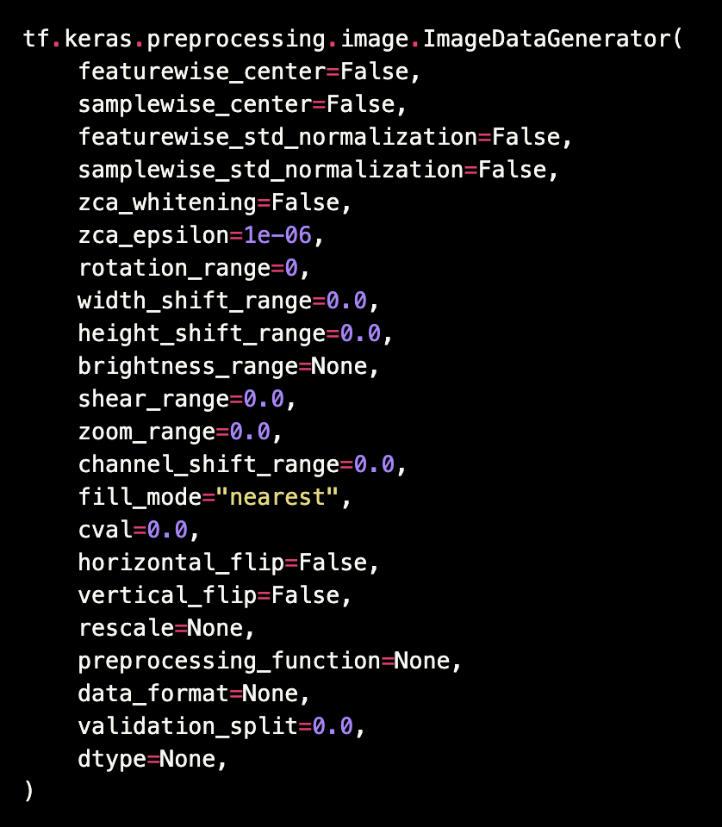
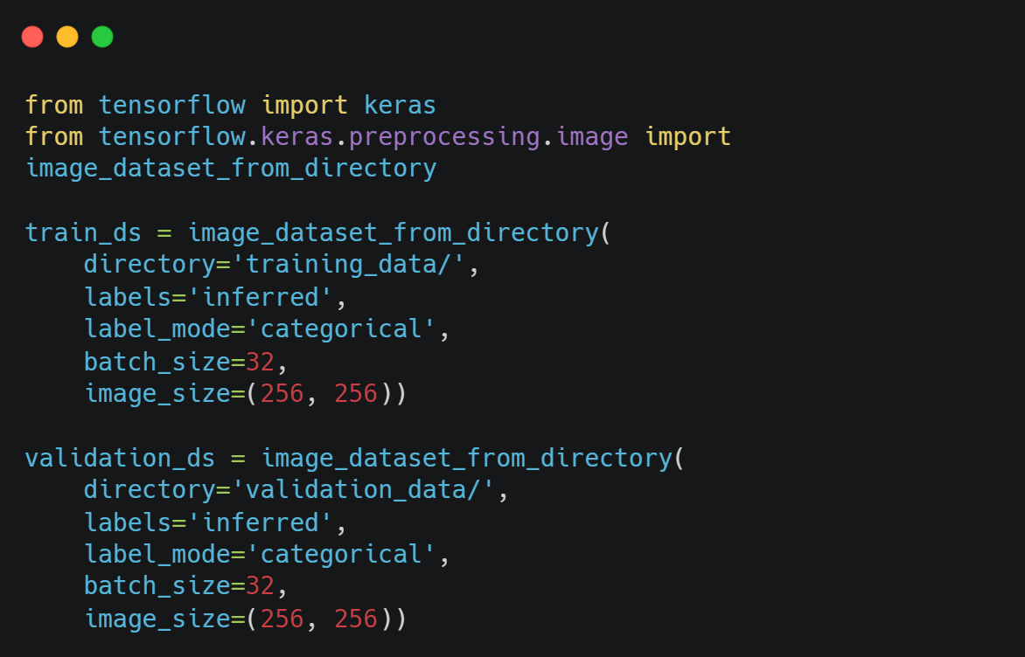
Data Preprocessing
Data preprocessing; involves transforming raw data into well-formed data sets so that deep learning can be applied.
Data preprocessing directly affects results.

Slide 23
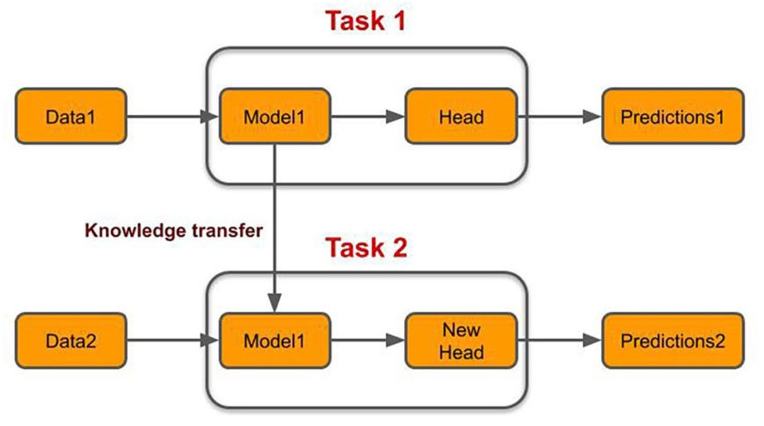
Transfer Learning
Transfer learning consists of taking features learned on one problem, and leveraging them on a new, similar problem. Transfer learning is usually done for tasks where your dataset has too little data to train a full-scale model from scratch.

Slide 24
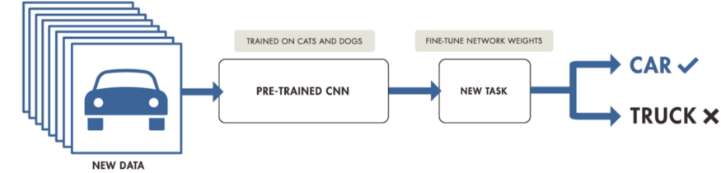
Transfer Learning Workflow
Take layers from a previously trained model.
Freeze them, so as to avoid destroying any of the information they contain during future training rounds.
Add some new, trainable layers on top of the frozen layers. They will learn to turn the old features into predictions on a new dataset.
Train the new layers on your dataset

Slide 25
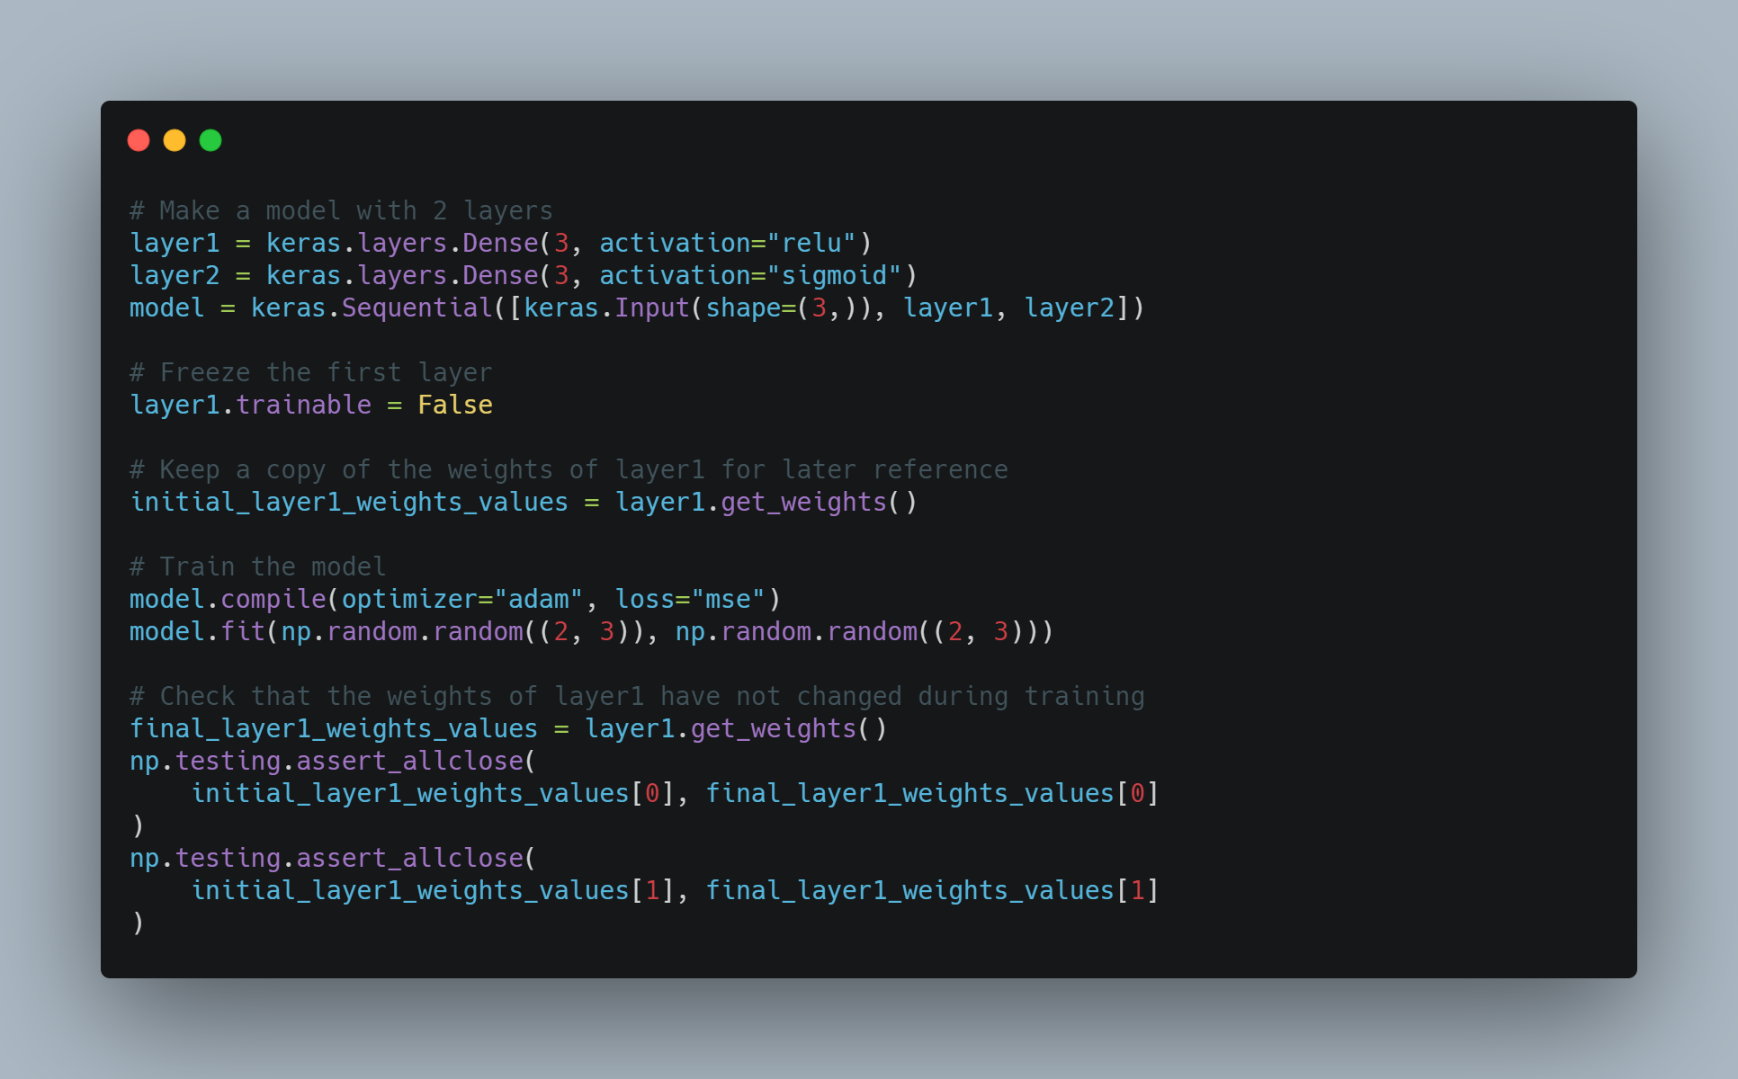
Transfer Learning and Freezing Layers
Using Transfer Learning you should freeze some layers, mainly the pre-trained ones and only train in the added ones, and decrease the learning rate to adjust the weights without mixing their meaning for the network.
Freezing a layer prevents its weights from being modified. This technique is often used in transfer learning, where the base model (trained on some other dataset) is frozen.

Slide 26
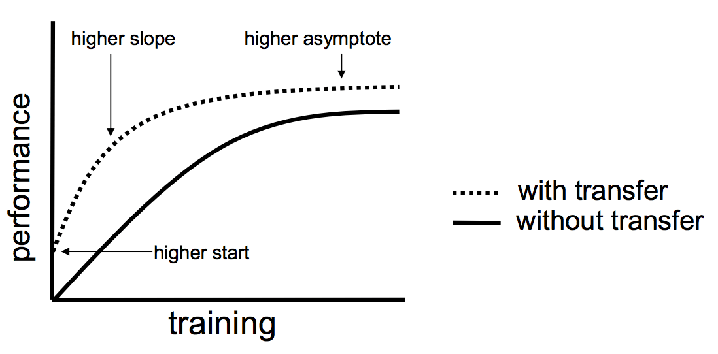
Transfer Learning and Benefits
Better initial model: In other types of learning, you need to build a model without any knowledge. Transfer learning offers a better starting point and can perform tasks at some level without even training.
Higher learning rate: Transfer learning offers a higher learning rate during training since the problem has already trained for a similar task.
Higher accuracy after training: With a better starting point and higher learning rate, transfer learning provides a machine learning model to converge at a higher performance level, enabling more accurate output.
Faster training: The learning can achieve the desired performance faster than traditional learning methods since it leverages a pre-trained model.

Slide 27
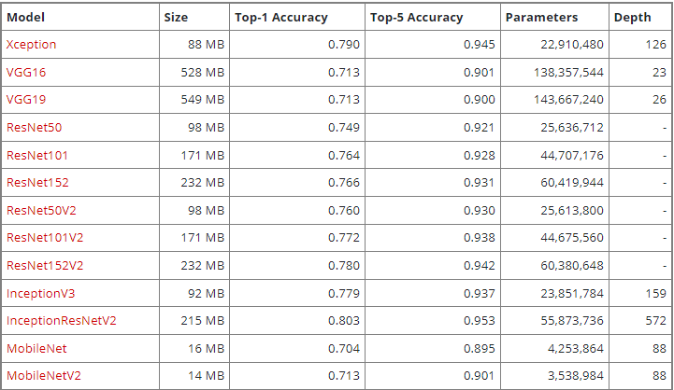
TensorFlow and Keras Applications
TensorFlow and Keras Applications are deep learning models that are made available alongside pre-trained weights. These models can be used for prediction, feature extraction, and fine-tuning.

Slide 28
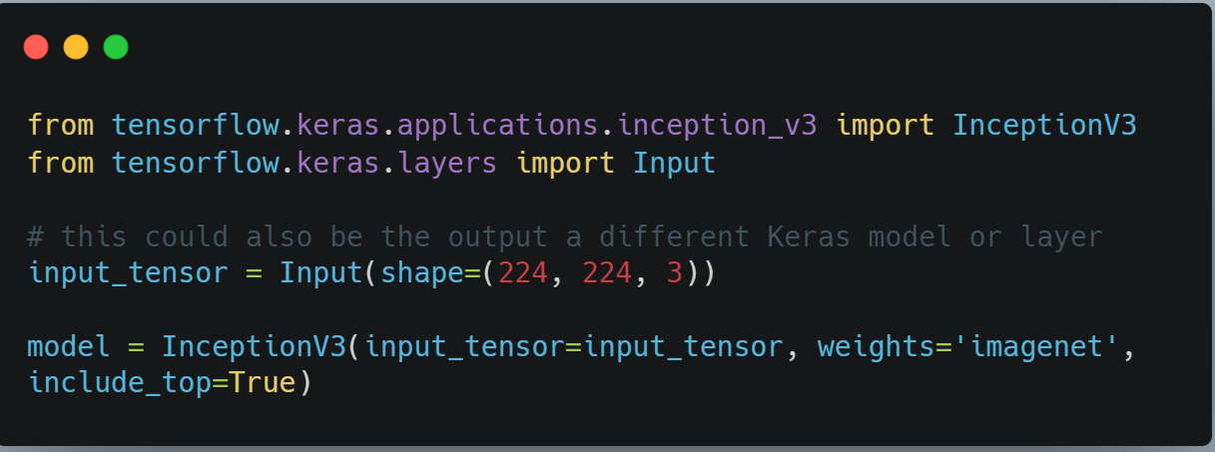
InceptionV3 Application Example
Import InceptionV3 and load to model example with code.

Slide 29
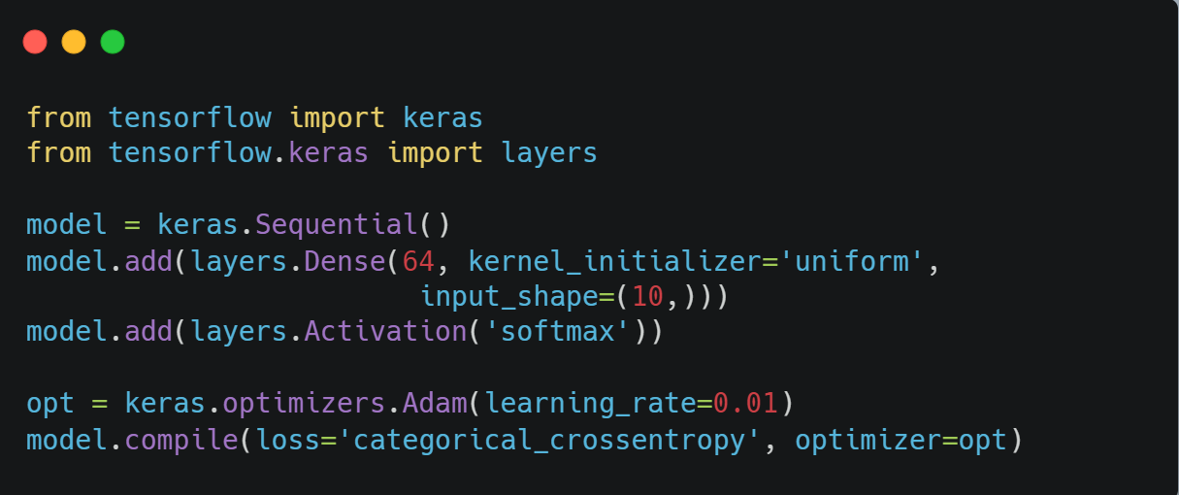
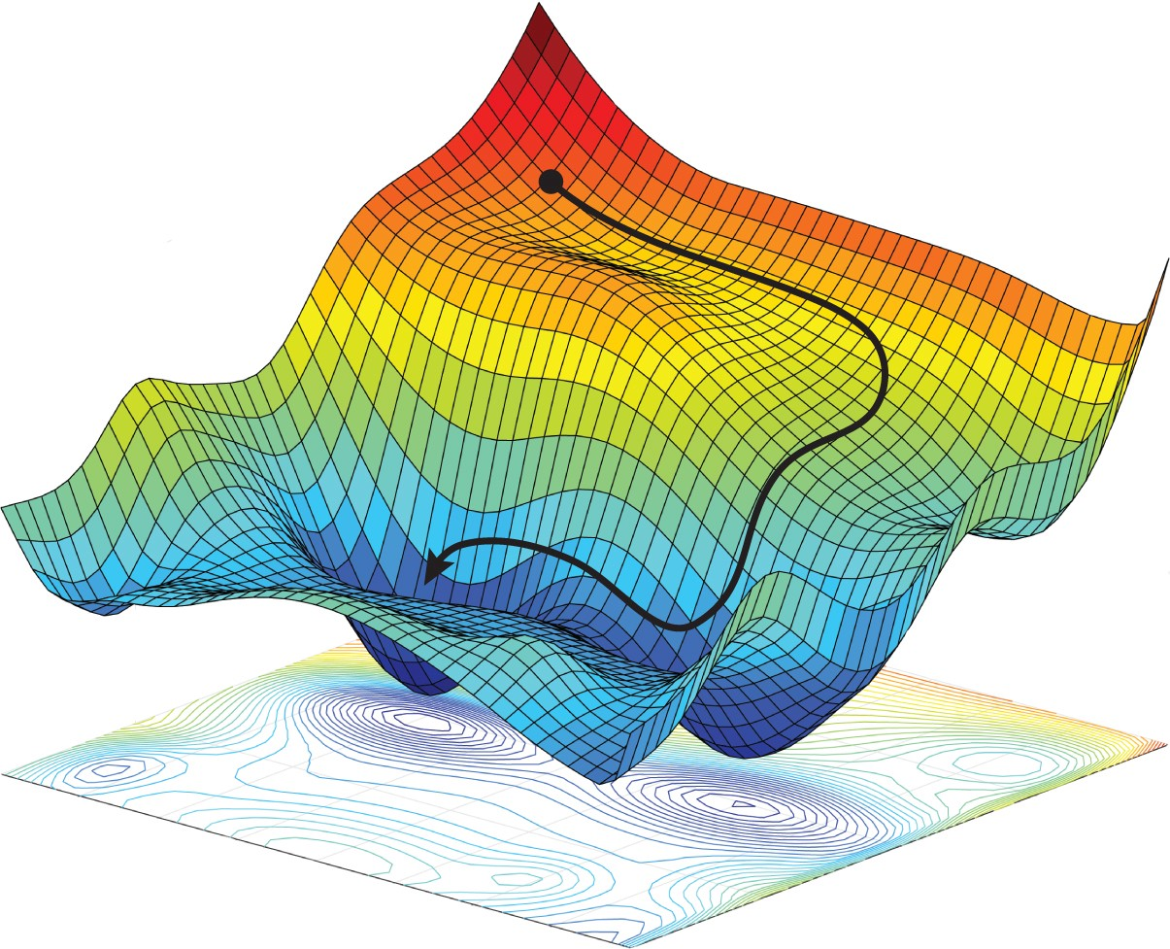
Optimizer
Optimizers are algorithms or methods used to minimize an error function (loss function) or to maximize the efficiency of production

Slide 30
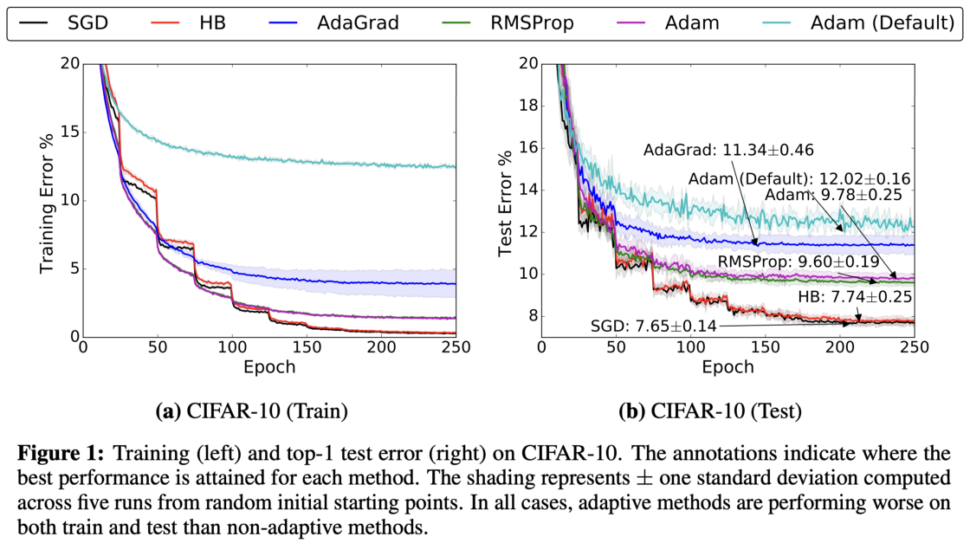
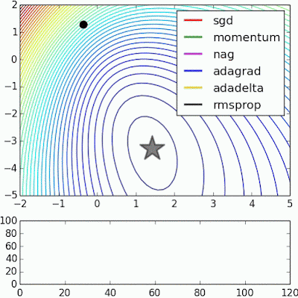
Optimizer

Slide 31
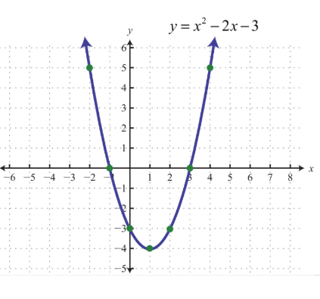
Why we use gradient?

Slide 32
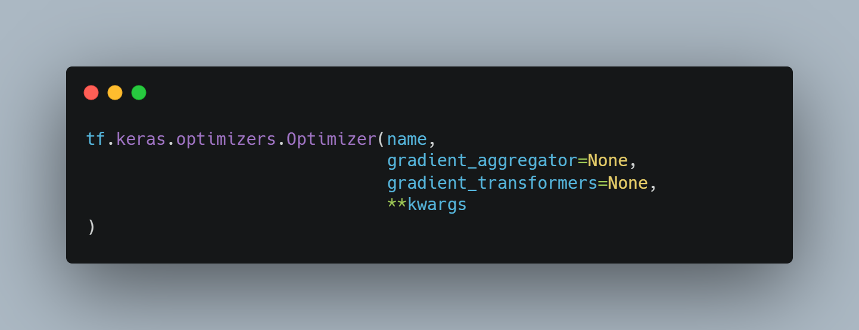
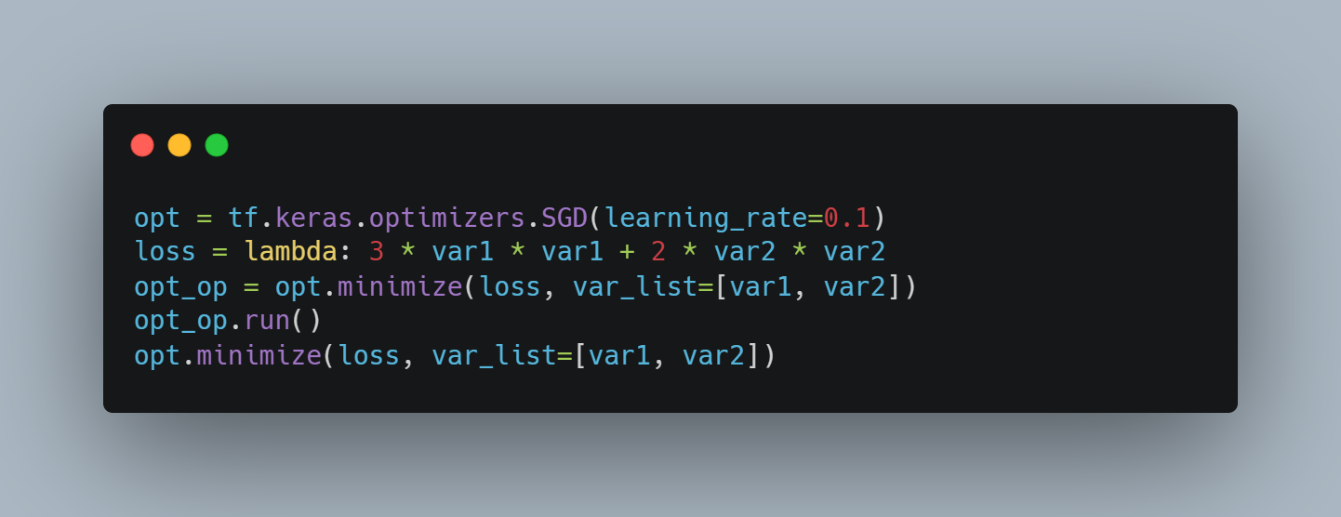
Optimizer
Some optimizer varieties;
Adam
SGD
RMSprop
Adadelta
Adagrad
Adamax
Ftrl
Nadam

Slide 33
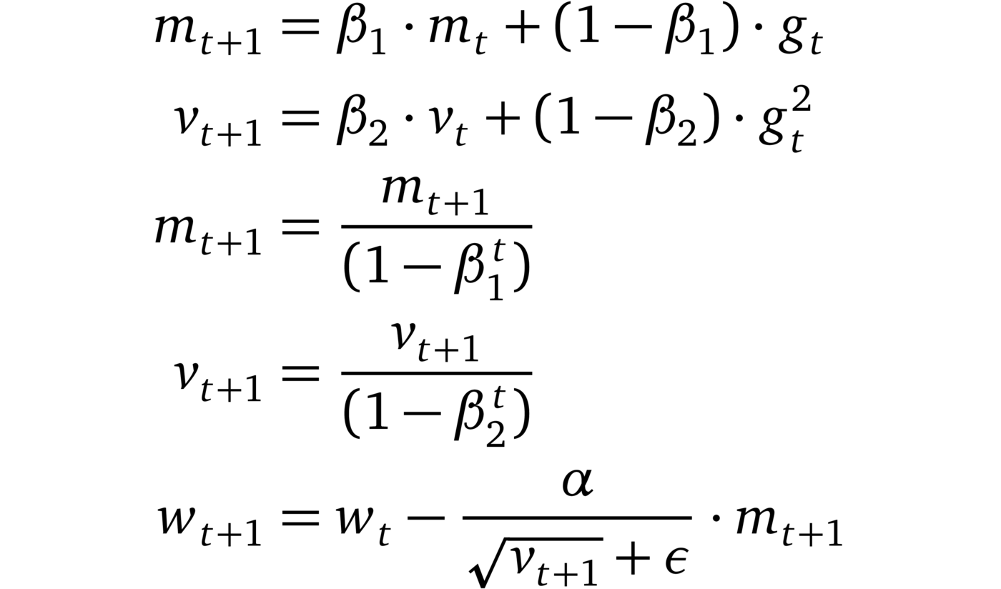
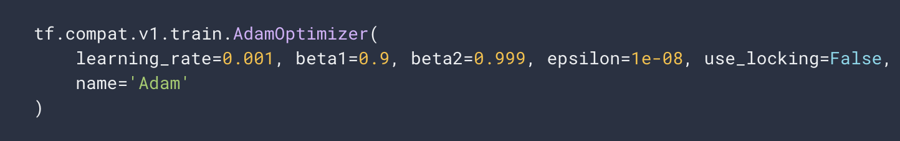
Optimizer
* https://www.lightly.ai/post/which-optimizer-should-i-use-for-my-machine-learning-project

Slide 34
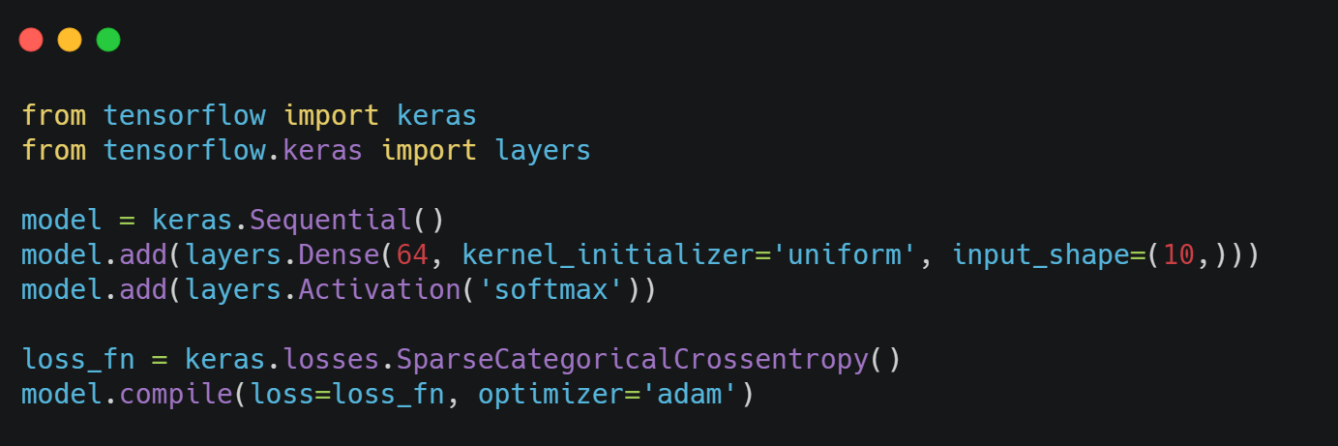
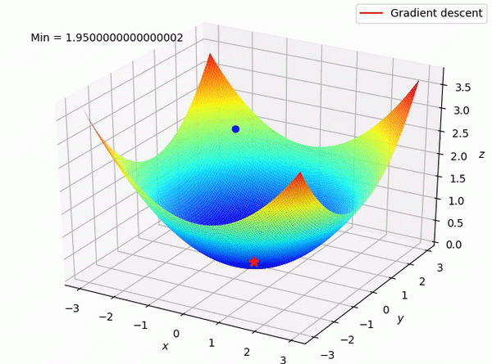
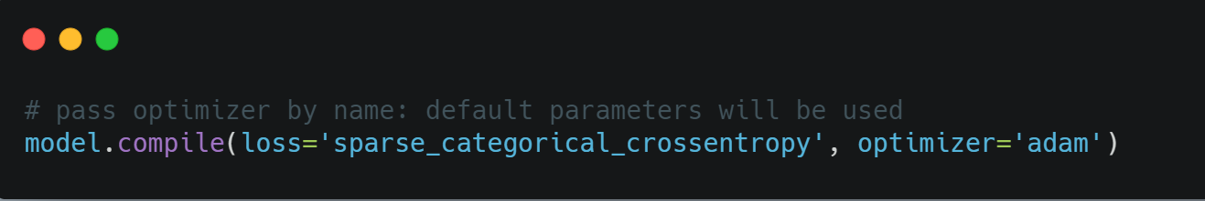
Loss Function
The purpose of loss functions is to compute the quantity that a model should seek to minimize during training.

Slide 35
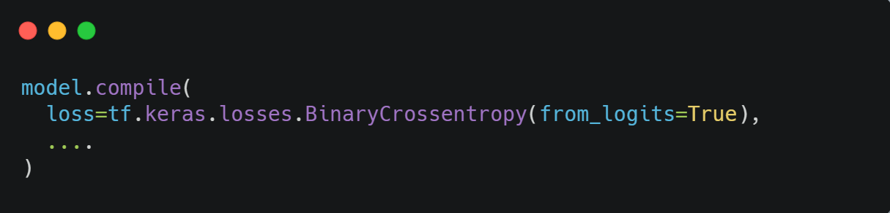
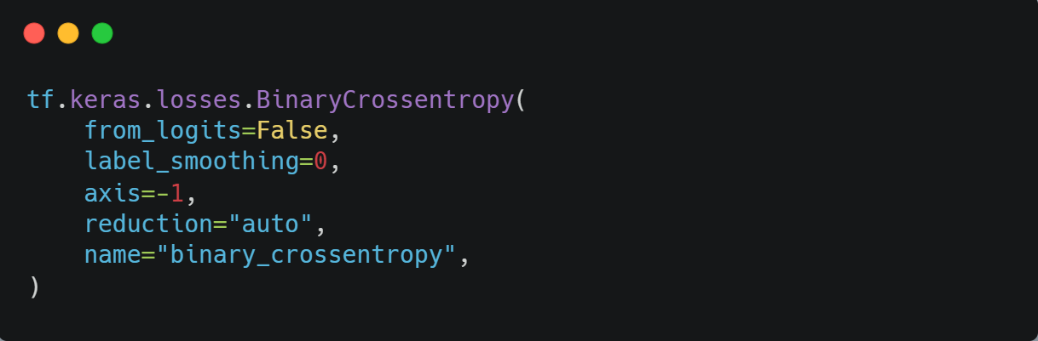
Loss Function
Some loss Function varieties
BinaryCrossentropy
CategoricalCrossentropy
Poisson
MeanSquaredError
MeanAbsoluteError
LogCosh
SquaredHinge
Reduction
CategoricalHinge
CosineSimilarity

Slide 36
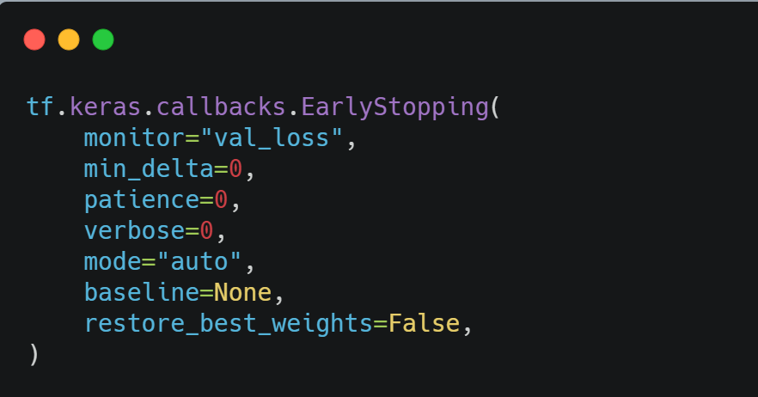
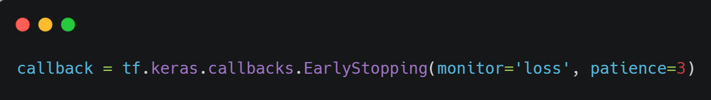
Callbacks
A callback is an object that can perform actions at various stages of training (e.g. at the start or end of an epoch, before or after a single batch, etc).
You can use callbacks to:
Write TensorBoard logs after every batch of training to monitor your metrics
Periodically save your model to disk
Do early stopping
Get a view on internal states and statistics of a model during training
...and more

Slide 37
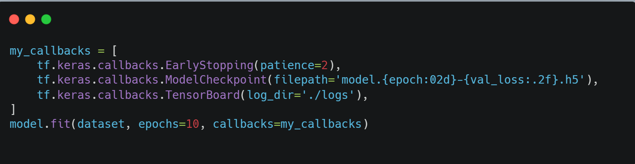
Callbacks
Base Callback
ModelCheckpoint
Tensorboard
EarlyStopping
LearningRateScheduler
ReduceLROnPlateau
RemoteMonitor
CSVLogger

Slide 38
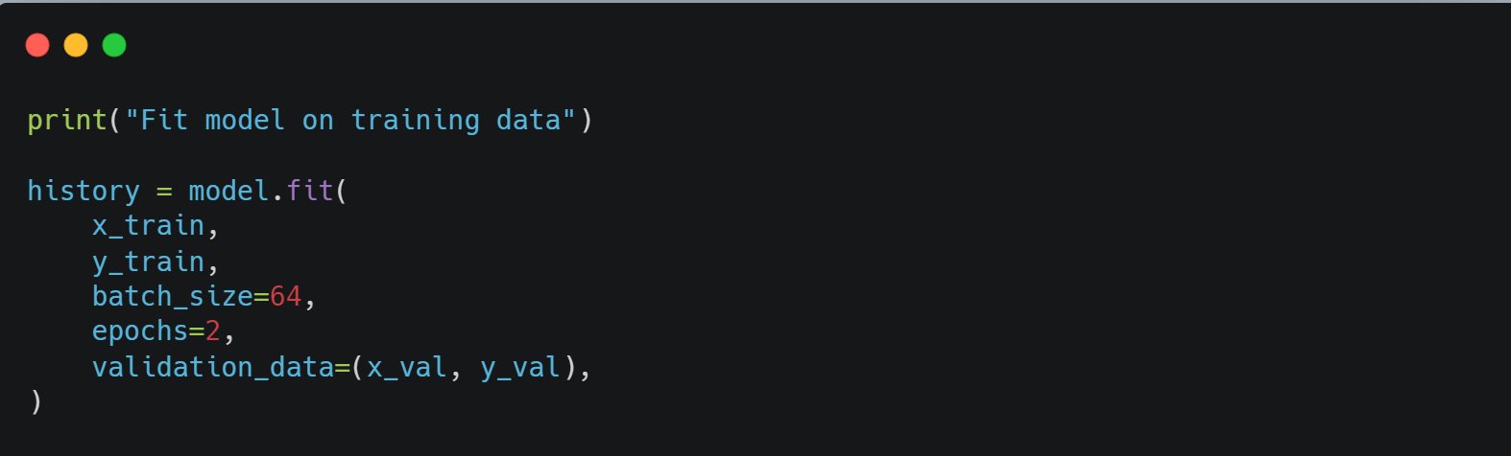
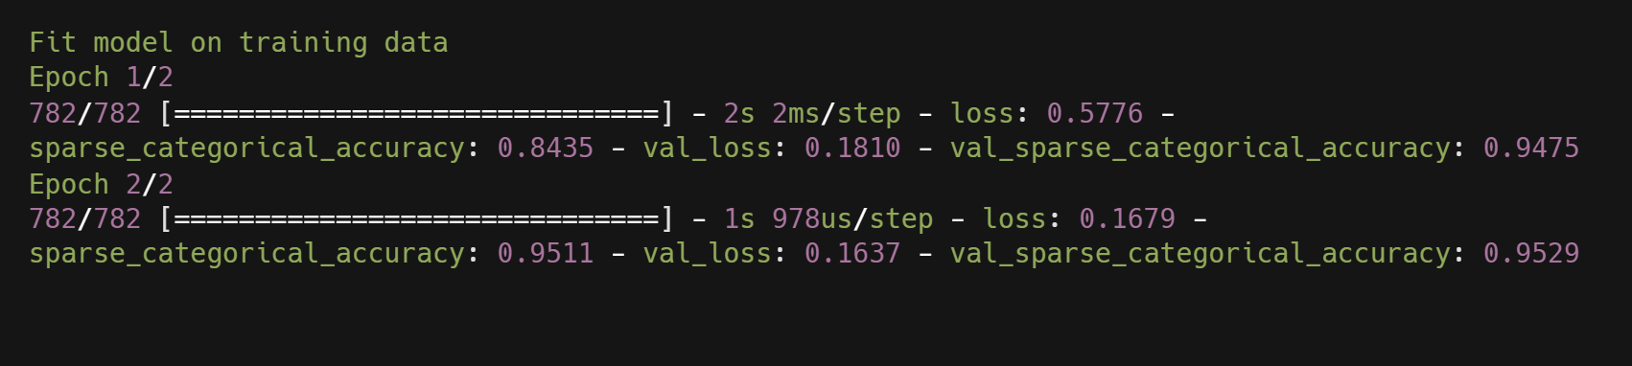
Training Phase
Training is the process of “teaching” a Deep Neural Network to perform the desired AI task (such as image classification or converting speech into text) by feeding it data, resulting in a trained deep learning model.

Slide 39
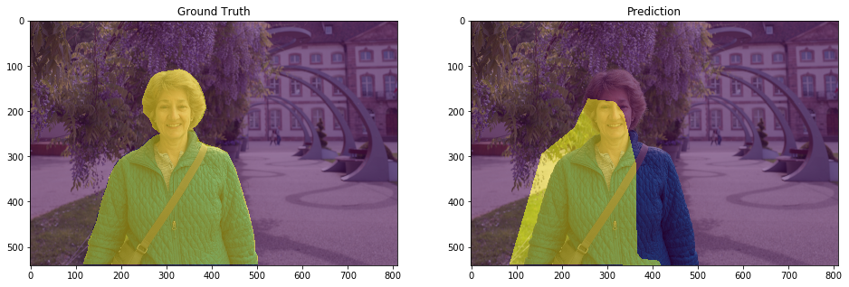
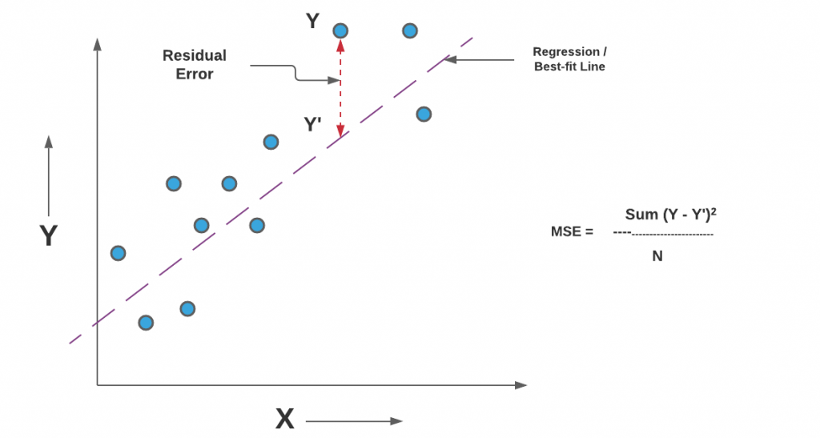
Metrics
A metric is a function that is used to judge the performance of your model.
Metric functions are similar to loss functions, except that the results from evaluating a metric are not used when training the model. Note that you may use any loss function as a metric.

Slide 40
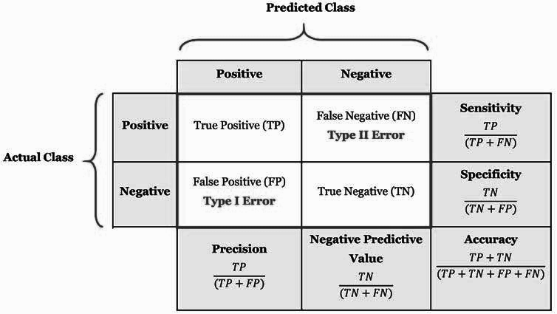
Metrics
Accuracy
BinaryAccuracy
CategoricalAccuracy
TopKCategoricalAccuracy
BinaryCrossentropy
CategoricalCrossentropy
SparseCategorialCrossentropy
MeanSquaredError
MeanAbsoluteError

Slide 41
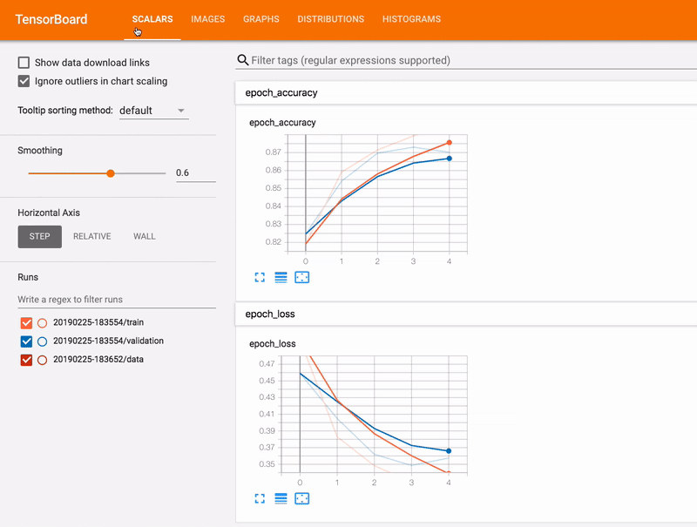
Tensorboard
Tracking and visualizing metrics such as loss and accuracy
Visualizing the model graph
Viewing histograms of weights, biases, or other tensors as they change over time
Projecting embeddings to a lower dimensional space
Displaying images, text, and audio data
Profiling TensorFlow programs
And much more

Slide 42
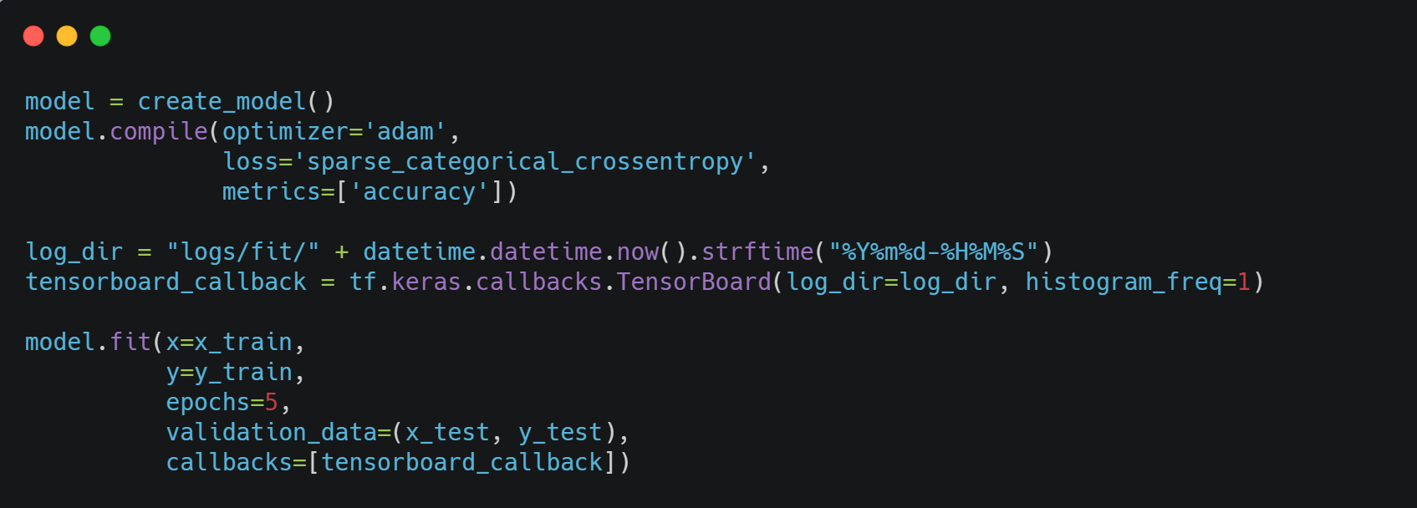
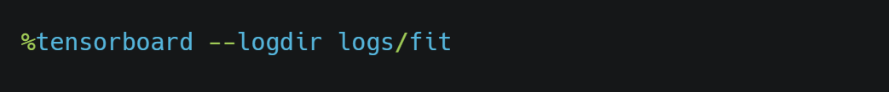
Tensorboard
It is run inside the tensorboard callback function

Slide 43

TensorFlow Hub is
a repository of trained
machine learning models

Slide 44

TensorFlow Hub
TensorFlow Hub reuse trained models like BERT and Faster R-CNN with just a few lines of code.

Slide 45

TensorFlow.js for
machine learning on the web

Slide 46




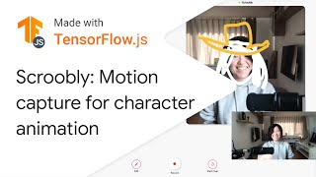
TensorFlow.js: Train + Deploy ML Models to the Browser

Slide 47

TensorFlow.js Examples
Can find more examples in tensorflow.org/js

Slide 48

TensorFlow.js
Using Script Tags
Installation from NPM and using a build tool like Parcel, WebPack or Rollup

Slide 49

TensorFlow Lite
for mobile and embedded ML

Slide 50




Lower latency
Network connectivity
Privacy preserving

Slide 51




Latest on-device ML with TensorFlow Lite

Slide 52
Latest on-device ML with TensorFlow Lite

Slide 53

TensorFlow Lite
Can find more TensorFlow Lite examples in tensorflow.org/lite/examples/

Slide 54
Practical Session
Classification with Transfer Learning

